Slide 1
HDF5 and high speed detectors
Nick Rees
and Frederik Ferner, Greg Matthews, Tina Friedrich, Ulrik Pedersen, Matt Pearson, Jon Thompson, Tom Cobb, Tobias Richter, Mark Basham, Graeme Winter etc....

Slide 2
High Speed Detectors

Slide 3
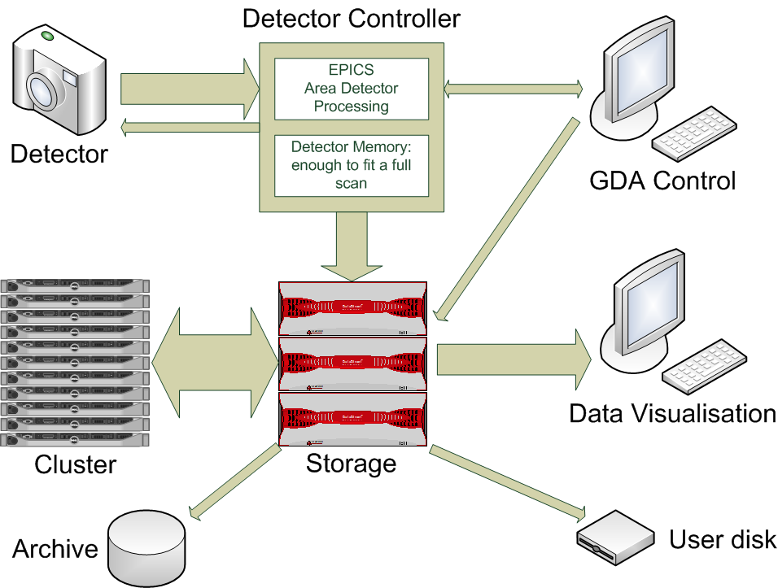
DLS High Data Rate Approach

Slide 4
Data Rates while Data Taking
Read speeds
Write speeds
MB/s
0 500 1000 1500 2000 2500 3000 3500 4000
12:20 12:30 12:40 12:50 12:40
Time (minutes)

Slide 5
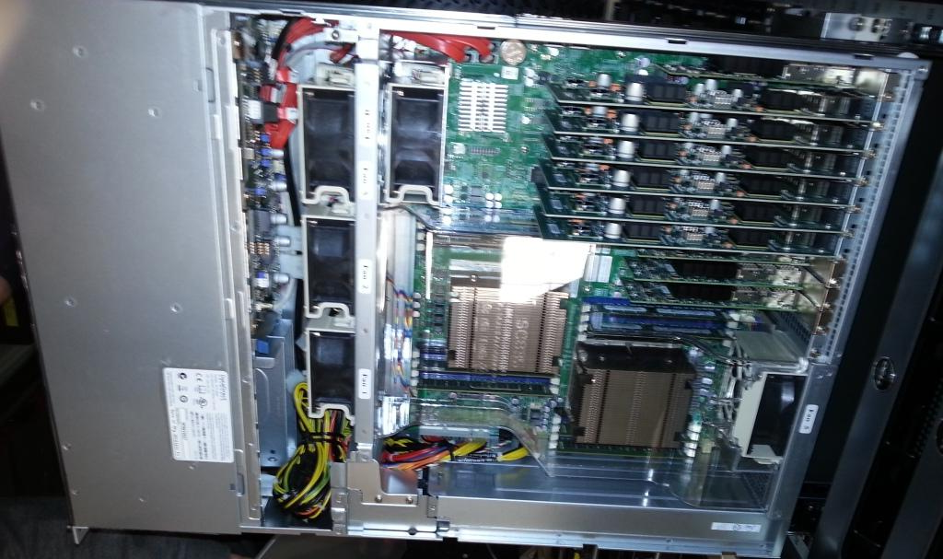
Modern Servers are Fast
DDN SFA12K-40
40 GB/sec controller pair
Each controller is a dual socket Supermicro Sandy Bridge system.
Runs a Linux variant
~ 10 GB/sec/socket throughput.
IB in one end, SAS out the other...

Slide 6
... but hardware is important

Slide 7
Typical modern detector
Master Node
FEM
Readout Node
FEM
Readout Node
Sensor/Medipix3 Hybrids
FEM
Readout Node
FEM
Readout Node
Network
FEM
Readout Node
FEM
Readout Node
Detector head
10GigE
Optical Links

Slide 8
Example Diamond Detectors
Current detectors
MX Detector:100 Hz Pilatus 6M (600 MB/sec write).
Tomography detector: 2 PCO.edge systems writing simultaneously (2x900 MB/sec).
Excalibur – 6 parallel Medipix3 detector controllers.
Future detectors:
Dectris Eiger (5 GB/sec raw, less compressed)
Percival (3-6 GB/sec)

Slide 9
Detector Block Diagram
Detector Control
Detector Array
Detector Control Software
Detector Wire Protocols
Detector Data Stream (n copies)
Control Driver
Data Receiver
Data Processing:
2 bit gain handling
DCS subtraction
Pixel re-arrangement
Rate correction(?)
Flat field
Dark subtraction
Efficiency correction
Documented
Controlled
Interfaces
Configuration
Cmd
Status
HDF5 file
Control Server
Beamline Control Software
Detector API
Data Compression
Detector Engineer Software
EPICS/ Area Detector
Tango/ Lima
Calibration
Software
HDF5 File Writer
Actual/potential network or CPU socket boundaries
HDF5 file

Slide 10
areaDetector plugin chain
Camera
ND-Process
ffmpeg-Stream
NDROI
NDROI
NDStd-Arrays
NDFile-TIFF
NDFile-HDF5
NDROI
NDStats
NDStats

Slide 11
Single Thread File Writes
Lustre 1.8
115 MB, 1 GbE
~400 MB/s, 10 GbE with checksums on
~750 MB/s, 10 GbE with checksums off
Reports of ~ 1100 MB/s with IB
Client thread saturates 100% of 1 core.
2.3.0 Servers, 1.8.8 Clients
~500 MB/s, 10 GbE with checksums on
~700 MB/s, 10 GbE with checksums off
2.3.0 Servers, 2.3.0 Clients
~440 MB/s, 10 GbE (no difference with or without checksums)
Big difference when writing less data than the client has RAM.
Servers are relatively old by today's standards (Dell 2970).
Still see some client thread saturation
GPFS
115 MB/s, 1 GbE
1150 MB/s, 10 GbE
2294 MB/s, 2 x 10 GbE
2100 MB/s, QDR IB

Slide 12
Some more numbers...
Aggregate file system throughputs:
First Diamond Lustre system: ~3 GB/sec
Second Diamond Lustre system: ~5-6 GB/sec
New Diamond GPFS system: > 20 GB/sec
Compression:
Dectris proposing LZ4
1.3 GB/sec/thread compression
Diffraction compression: 30-60x
BioSAXS compression: ~100x
Imaging compression: negligible...
However, in library HDF5 compression has a maximum throughput of ~500 MB/sec (for No-Op compression).

Slide 13
HDF5 Developments

Slide 14
HDF5 pros and cons
Pros:
Extremely solid data model
Very high performance for simple data streaming.
A large number of features for high performance computing.
Widely used, de facto standard.
Extremely good support company – Dectris commented that The HDF Group was one of the best companies they had ever dealt with.
Large user community.
Cons
Non re-entrant, with a global library lock.
In-library data compression filters have a performance hit.
Files cannot be read an written simultaneously (yet).

Slide 15
HDF5 Data Files
EPICS and GDA both need to write the data file.
We use HDF5 links to create one logical file from multiple real files.
Avoids file contention issues.
Allows detector files to be highly optimised for performance.
The header data is written directly by GDA.
The detector data is written using EPICS HDF5 area detector plugin.
GDA
EPICS
Header Data .nxs file
HDF5 link
Detector Data .hdf5 file
HDF5 link
Detector Data .hdf5 file

Slide 16
Example: Tomography
Tomography scans are demanding:
Data rate ~ 500 MB/s.
Data size > 100 GB.
First operation is read data perpendicular to write direction.
Classic matrix transpose problem
Real challenge for typical cache design.
Completely unsuited to running inside the GDA server.
Image Frames
Sinogram Frames

Slide 17
Tomography data file format
Data must be optimised for reading sinograms.
All frames are written to a single file.
File is arranged in chunks of a fixed number of rows and a fixed number of frames.
The chunk size matches the Lustre stripe size so is written to a different Lustre server.
Data is in cache until all frames in a chunk are written.

Slide 18
Recent HDF5 developments
Last year the following developments were funded:
Writing of pre-compressed chunks.
Acquisition software can pre-compress data efficiently (i.e. in parallel), and write those directly to the HDF5 file without going through the HDF5 filtering mechanism.
Implemented by The HDF Group, funded by PSI and Dectris.
Filter plugins
User can supply a shared library at run-time that implements an HDF5 filter.
Allows the user to read and write compressed datasets with custom compression algorithms without recompiling the application by dynamically loading the corresponding filter.
Implemented by The HDF Group, funded by DESY.
Available in HDF5 1.8.11 (May 2013)

Slide 19
Future HDF5 developments
Single Writer Multiple Reader (SWMR)
Data can be added and modified, but file hierarchical structure cannot be changed.
Writer task pre-creates file structure and then enables SWMR.
Reader tasks open file with read-only and SWMR flags and can then read data as it becomes available.
A Reader always sees a consistent HDF5 file - no errors occur while reading HDF5 metadata and raw data.
If the Writer crashes, it leaves the file in a non-corrupted state.
There is no performance penalty for file access and modifications under SWMR.
Available in HDF5 v1.10.0 (2014)
Funded by Diamond, Dectris and ????

Slide 20
Future HDF5 developments
Independent parallel compressed writing
Allow multiple independent writers to write a compressed HDF5 in parallel
Each system actually writing a separate file, but there is a master file containing a “Virtual dataset” (VDS) that describes how the daughter datasets are joined together to make the parent dataset.
Has many other use cases, not just parallel compressed writing:
Manipulating NASA/GSFC National Polar-orbiting Partnership, Joint Polar Satellite System data files.
NASA Earth Science Data and Information System time series data
Currently developing requirements and use cases for implementation later this year.
Funded by Diamond and ???

Slide 21
Summary
Detectors are getting bigger and faster
With sufficient resources the data rates are manageable.
HDF5 is a great file format.
There are a few issues, but we are addressing many of them,

